Slide 1

Hepatitis C Detection in Early Stage
Data Analysis using Supervised Machine Learning
Analyst： Ankit Dahate
Nikhil Bhor
Prajwal Bambulkar
Sarang Sonawane
Date：2023.03.27

Slide 2

01
What is Hepatitis C
02
How Machine Learning can help
contents
03
Data Analysis
04
Accuracy in Detection
05
Potential Benefits
06
Conclusion

Slide 3
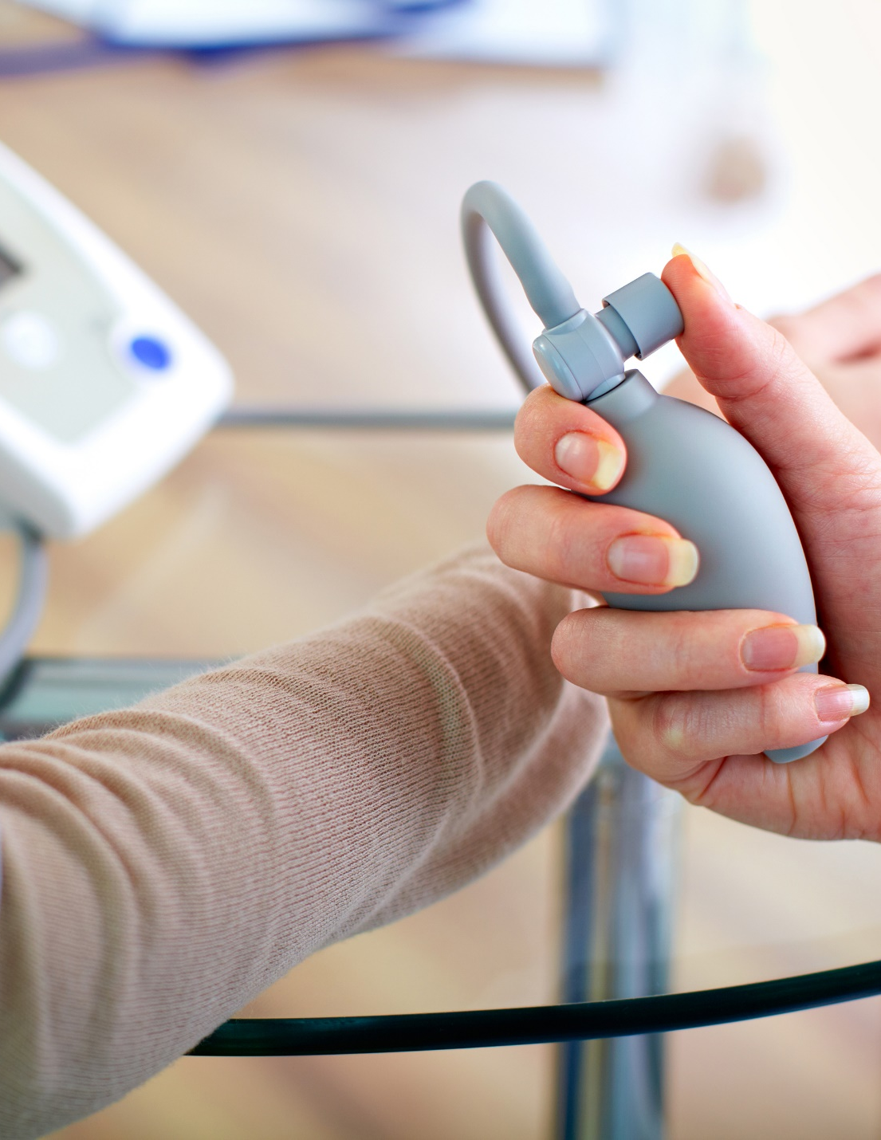
PART 01
What is Hepatitis C
Hepatitis C is a dangerous disease, with high fatality, hence prevention is the best remedy.

Slide 4



What is Hepatitis C
Overview
Hepatitis C is a viral infection that causes liver inflammation, sometimes leading to serious liver damage. The hepatitis C virus (HCV) spreads through contaminated blood.
Every chronic hepatitis C infection starts with an acute phase.
Acute hepatitis C usually goes undiagnosed because it rarely causes symptoms.
When signs and symptoms are present, they may include jaundice, along with fatigue, nausea, fever and muscle aches.

Slide 5
PART 02
How Machine Learning can help
Going through traditional pathway in detection is often complex, expensive and time-taking .

Slide 6






How Machine Learning can help
Developing predictive models
Personalizing treatment
Machine learning algorithms can be trained on large datasets of patient information to develop predictive models for hepatitis C detection.
Machine learning can be used to analyze patient data and develop personalized treatment plans for patients with hepatitis C.
Improving accuracy of diagnosis
Identifying risk factors
Machine learning algorithms can be used to analyze medical images, such as MRI or CT scans, to identify patterns that may be indicative of hepatitis C.
Machine learning algorithms can be used to identify risk factors that may be associated with hepatitis C, such as demographic factors or lifestyle choices.
Identifying biomarkers
Monitoring disease progression
Machine learning can be used to analyze biological data, such as gene expression data or protein levels, to identify biomarkers that are associated with hepatitis C.
Machine learning can be used to monitor disease progression over time, using data such as blood tests or medical imaging results.

Slide 7
PART 03
Data Analysis
Comparing parameters, finding correlation and visualising data helps in gaining insights about available data.

Slide 8
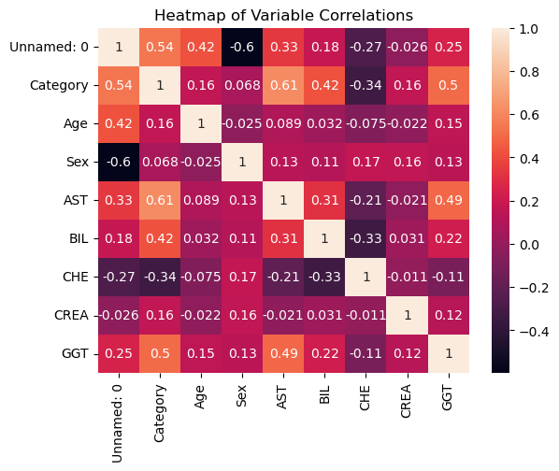
Data Analysis
Observation = Category has correlations with AST (Aspartate Transaminase), GGT (Gamma-Glutamyl Transferase), Acetylcholinesterase.

Slide 9
PART 04
Accuracy in Detection
Machine Learning models could be accurate as high as 92 to even 99%.

Slide 10
Accuracy in Detection
Random Forest Model
In the Random Forest Classifier we got accuracy of 97% .
Decision Tree Model
In the Random Forest Classifier we got accuracy of 99%.
SVM (Support Vector Machine)
In the SVM we got accuracy of 92%.

Slide 11
PART 05
Potential Benefits
Machine Learning could greately help in early detection, Cost Saving, Proper Resource Allocation, etc.

Slide 12
Potential Benefits
Early detection
Resource allocation
Machine learning algorithms can detect hepatitis C in its early stages, allowing for timely intervention and treatment.
By identifying patients with hepatitis C earlier, healthcare providers can allocate resources more efficiently, including diagnostic tests, medical equipment, and staffing.
Improved accuracy
Public health benefits
Machine learning algorithms can accurately identify hepatitis C in patients, potentially reducing the need for invasive diagnostic procedures and improving patient comfort.
Early-stage detection of hepatitis C can also have broader public health benefits, such as reducing the risk of transmission to others and preventing the progression of the disease in infected individuals.
Cost savings
Personalize Treatment
Early detection of hepatitis C can result in cost savings for both patients and healthcare providers.
Machine learning algorithms can analyze large amounts of patient data and identify patterns that may not be apparent to human clinicians.

Slide 13
PART 06
Conclusion
Enter text here.Enter text here.Enter text here.Enter text here.

Slide 14
Conclusion
The highest correlation with classification was found for AST (glutamate aminotransferase) test values, followed by BIL (bilirubin) and GGT (glutamyl transpeptidase).
Transaminases, bilirubin, and glutamyl transpeptidase showed positive correlation with the probability of disease, and the higher the value, the more severe the disease.
Age, sex, bilirubin, and cholesterol did not have a significant degree of association with the probability of disease.
The Decision Tree Classifier has the Highest Accuracy 99%.

Slide 15
2023
THANK YOU！
Analyst： Ankit Dahate
Nikhil Bhor
Prajwal Bambulkar
Sarang Sonawane
Date：2023.03.27

